Slide 1
Predicting Biological Pathways Through the Clustering of Interaction Data
Jason Kuo

Slide 2
Overview
Definitions
Interaction
Graphs
Graph Clustering
Biological Pathways
Goals
Implementation
Code
Results
Issues

Slide 3
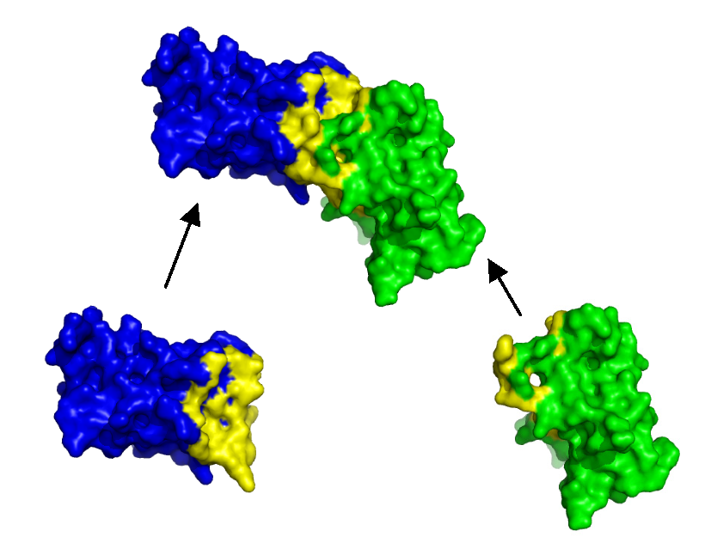
Interaction
Image from:
http://www.stats.ox.ac.uk/~hamer/images/complex.png
An interaction that has been characterized between two or more genes or proteins. The interaction can either be genetic (i.e. the effect that a mutation of a gene has on the phenotype of another gene), or physical (i.e. an actual physical interaction between two proteins).
Definition from:
http://yeastmine.yeastgenome.org/yeastmine/customQuery.do

Slide 4
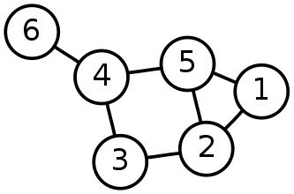
Graphs
Image from:
http://www.searchenginepeople.com/wp-content/uploads/2011/03/graph.png
Graphs are structures formed by a set of vertices (also called nodes) and a set of edges that are connections between pairs of vertices.
Definition from:
http://dollar.biz.uiowa.edu/~street/graphClustering.pdf

Slide 5
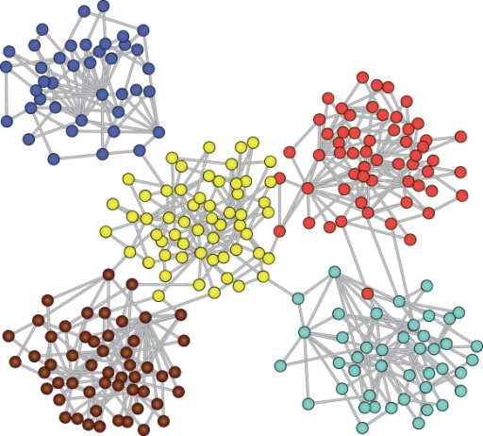
Clustering
Image from:
http://openi.nlm.nih.gov/imgs/512/80/2542420/2542420_pcbi.1000190.g004.png
Clustering is the task of grouping the vertices of the graph into clusters taking into consideration the edge structure of the graph in such a way that there should be many edges within each cluster and relatively few between the clusters.
Definition from:
http://dollar.biz.uiowa.edu/~street/graphClustering.pdf

Slide 6
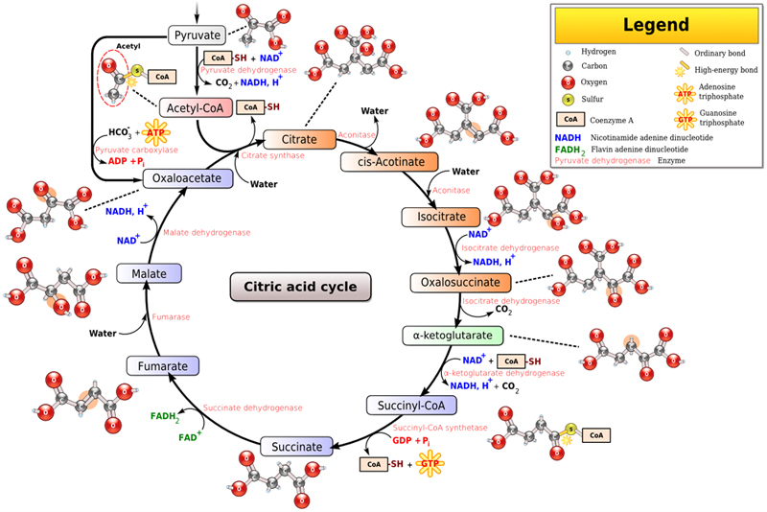
Biological Pathways
Image from:
https://uwaterloo.ca/applied-mathematics/sites/ca.applied-mathematics/files/uploads/images/k_cycle.jpg
A biological pathway is a series of actions among molecules in a cell that leads to a certain product or change in a cell.
Definition from:
https://en.wikipedia.org/wiki/Biological_pathway

Slide 7
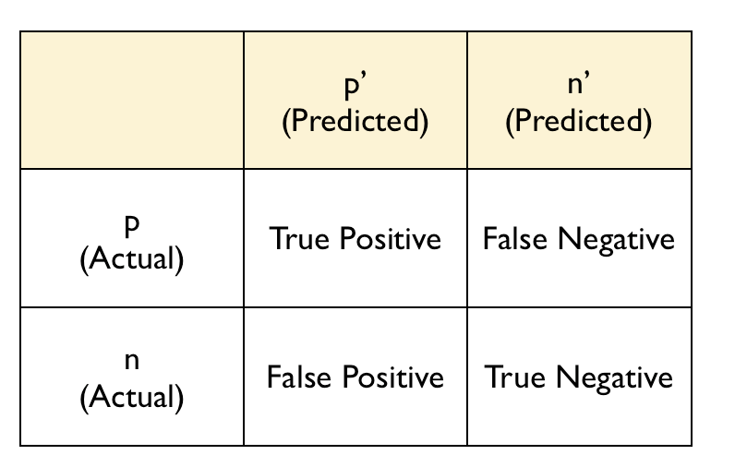
Confusion Matrix
Image from:
http://3.bp.blogspot.com/_txFWHHNYMJQ/THyADzbutYI/AAAAAAAAAf8/TAXL7lySrko/s1600/Picture+8.png
A confusion matrix contains information about actual and predicted classifications done by a classification system. Performance of such systems is commonly evaluated using data in the matrix.
Definition from:
http://www2.cs.uregina.ca/~dbd/cs831/notes/confusion_matrix/confusion_matrix.html

Slide 8
Goals
Find a clustering algorithm that can be used to cluster a graph made from interaction data where the nodes are different genes/proteins and the edges are the interactions specified by the data.
Determine if clusters of genes based on interaction data are good predictors of biological pathways.

Slide 9
Implementation
Download the interactions data from YeastMine.
Parse the data to create a graph using the networkx module in Python.
Cluster the graph using the Markov Clustering Algorithm.
Download the pathway data from YeastMine.
Remove all genes/proteins (from clusters) that do not appear in the pathway data.

Slide 10
Implementation
Compare each unordered pair of nodes (from clusters) to the pathway data to obtain a confusion matrix
True positive is putting a pair in the same cluster when they are in the same pathway.
False positive is putting a pair in the same cluster when they are not in the same pathway.
True negative is putting a pair in different clusters when they are in different pathways.
False negative is putting a pair in different clusters when they are not in different pathways.

Slide 11
Markov Clustering Algorithm (MCL)
MCL is a fast and scalable unsupervised cluster algorithm for graphs based on simulation of stochastic flow in graphs.
It simulates random walks within a graph by alternation of two operators called expansion and inflation.
Expansion coincides with taking the power of a stochastic matrix using the normal matrix product.
Inflation corresponds with taking the Hadamard power of a matrix (taking powers entrywise), followed by a scaling step such that the resulting matrix is stochastic again, i.e. the matrix elements (on each column) correspond to probability values.

Slide 12
Markov Clustering Algorithm (MCL)
Eventually, iterating expansion and inflation results in separation of the graph into different segments.
The inflation operator can be altered with the inflation parameter r. Increasing this parameter increases the granularity, or tightness, of the clusters.
A straightforward implementation of MCL will have time and space complexity respectively O(n³) and O(n²).

Slide 13
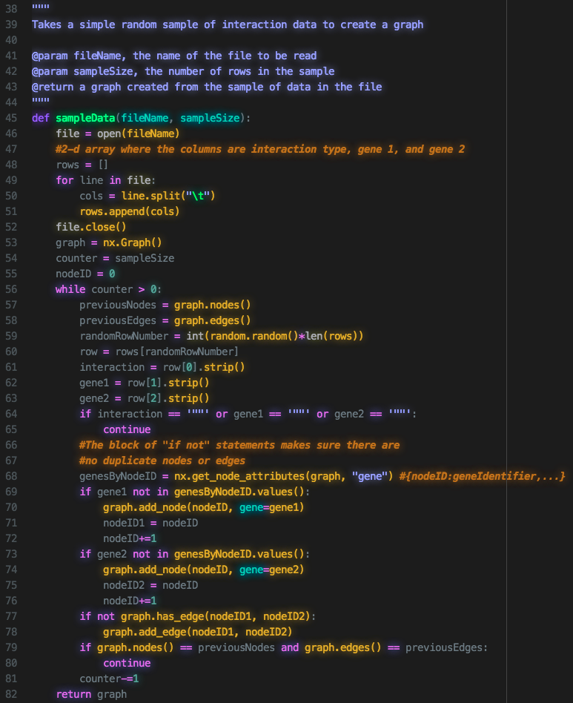

Slide 14
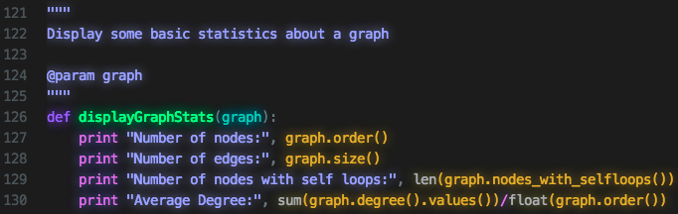

Slide 15
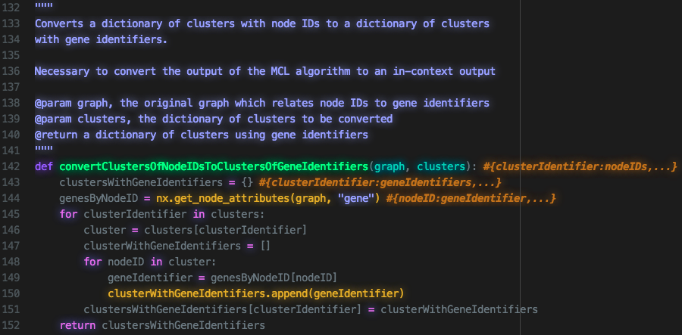

Slide 16
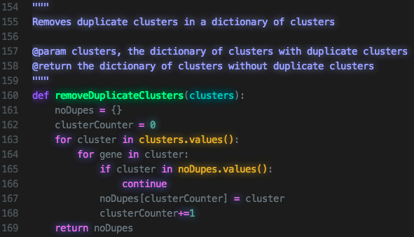

Slide 17
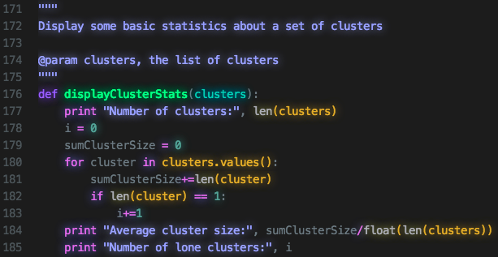

Slide 18
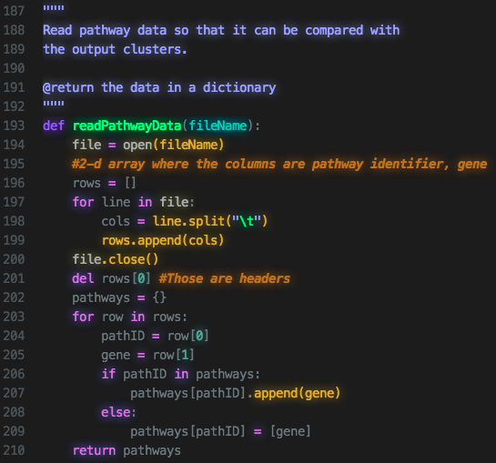

Slide 19
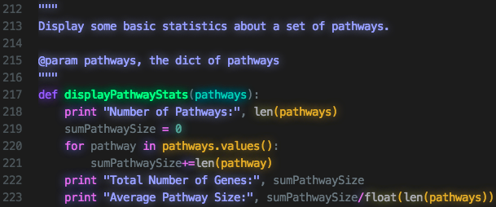

Slide 20
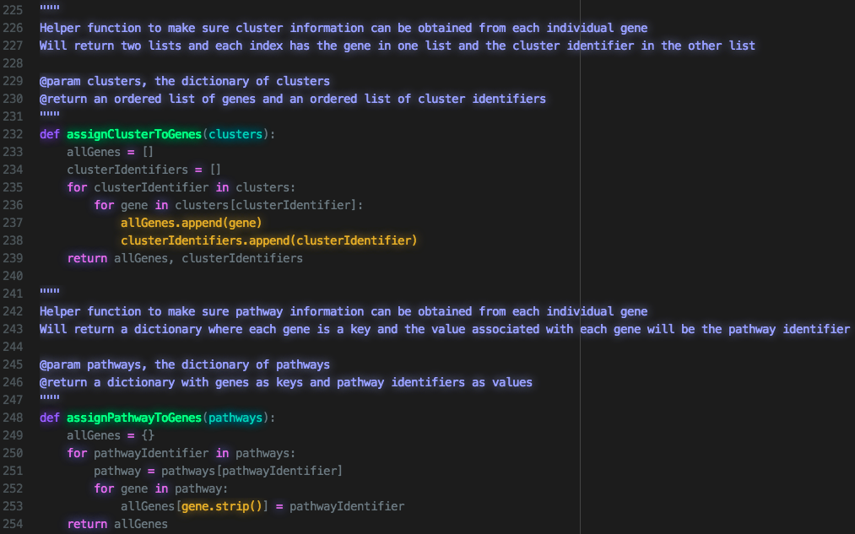

Slide 21
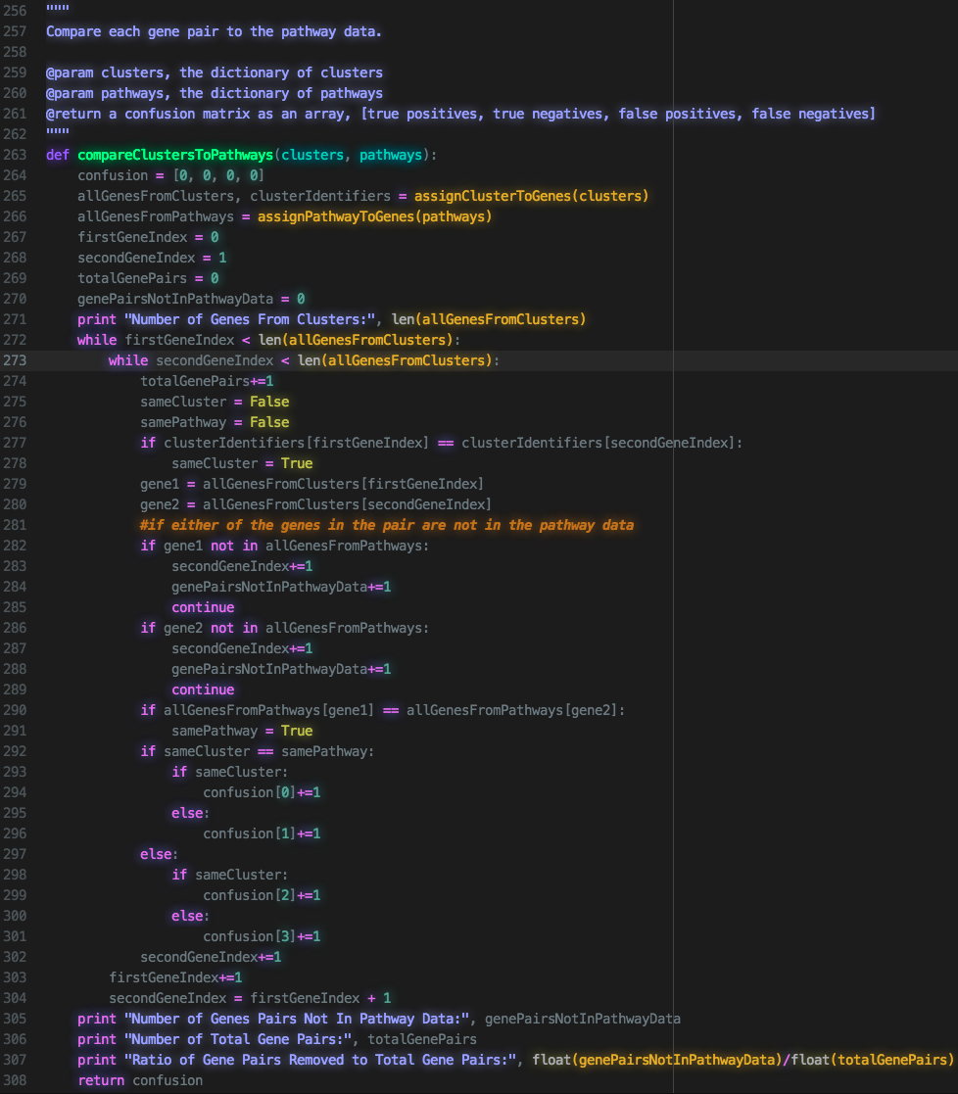

Slide 22
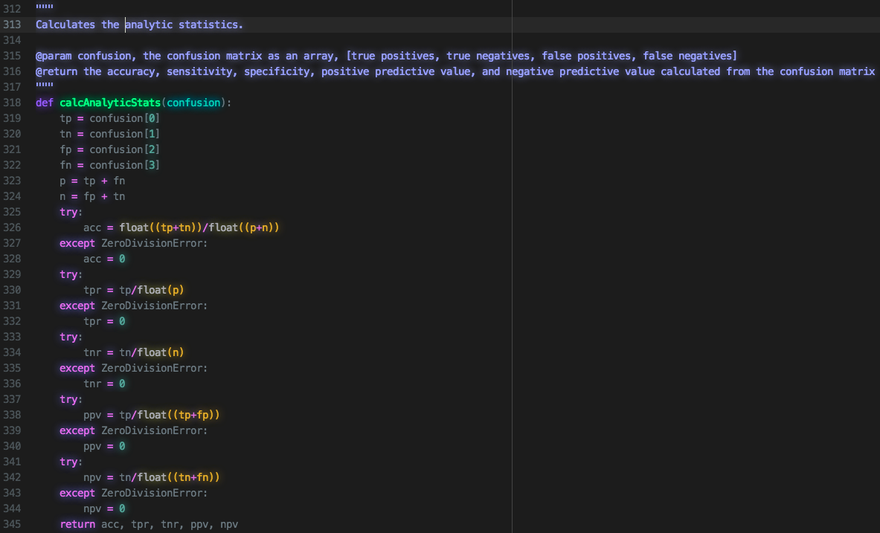

Slide 23
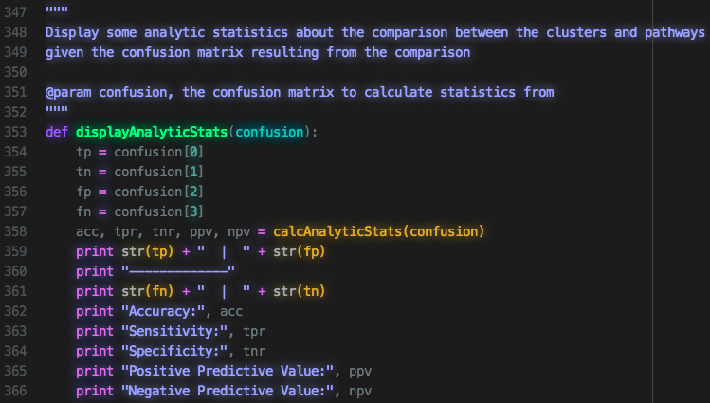

Slide 24
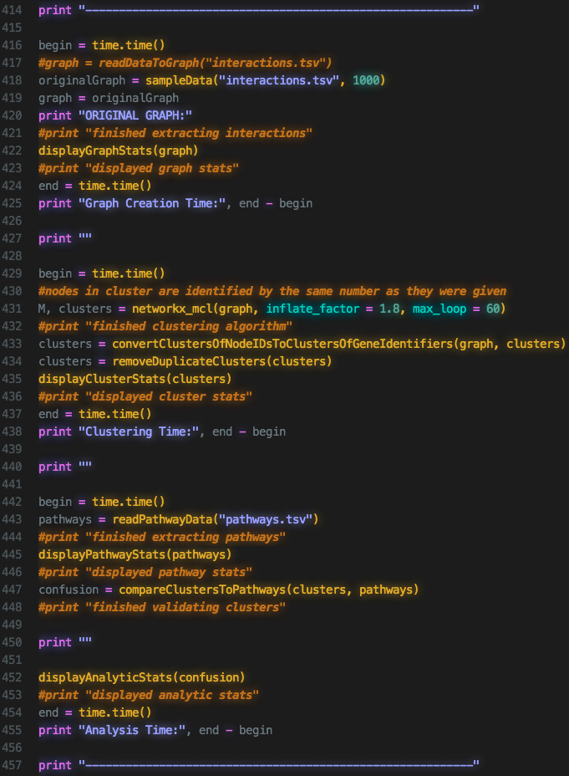

Slide 25
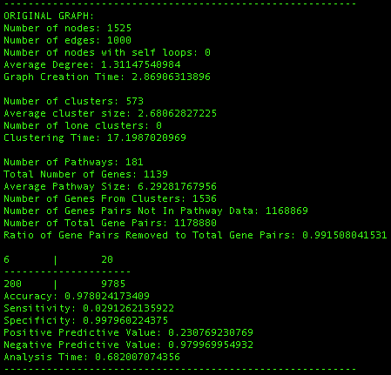
Results (Example Output)

Slide 26
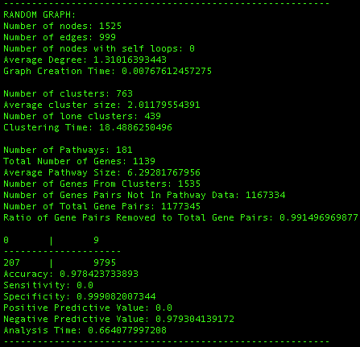
Results (Example Output)

Slide 27
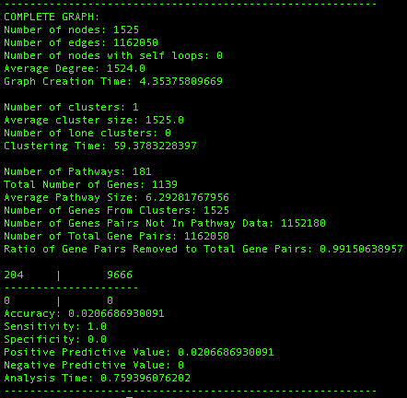
Results (Example Output)

Slide 28
Issues
Using this implementation, sampling must be used to reduce the runtime.
The accuracy statistic (calculated from the confusion matrix) is very high due to the large number of true negatives. This may make the algorithm seem better than it practically is.
So far, no test of how much better this method of prediction is compared to random chance.

